Slide 1
Javascript Dasar
HASAN
=| Hiduplah seperti Javascript |=

Slide 2


Let’s Learn Javascript

Slide 3

Jangan Percaya kalo ngoding itu SULIT!

Slide 4

What is Javascript?
bahasa pemrograman yang digunakan dalam pengembangan website agar lebih dinamis dan interaktif.

Slide 5

How Javascript Works?
Modifies HTML element
Calculate number
Create Object

Slide 6
Why Javascript?
Easy to learn
Small memory consumption
Powerful

Slide 7

Let’s see how Javascript was born!
Follow her, guys

Slide 8
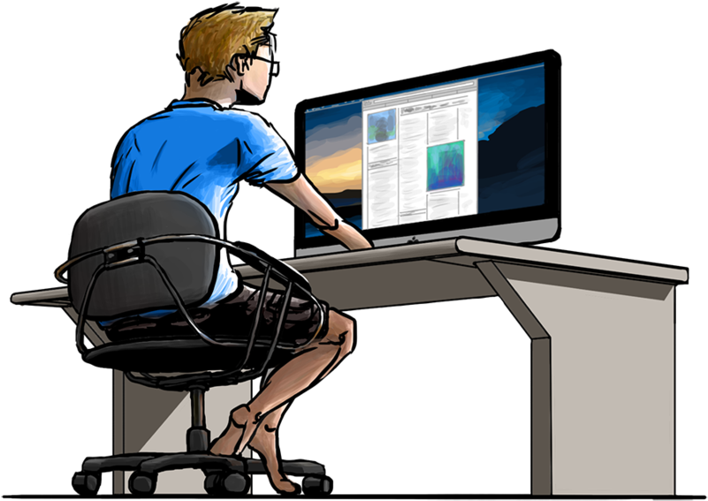

It’s time to code

Slide 9

<!DOCTYPE html>
<html>
<head>
<title>Hello World!</title>
</head>
<body>
<h1 style="color:white;width:400px;background-color:blue;text-align:center;padding:20px;border-radius:5px;">Hello World</h1>
</body>
</html>

Slide 10
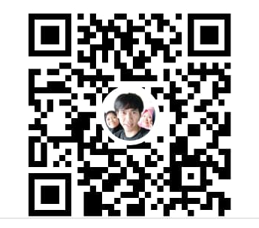
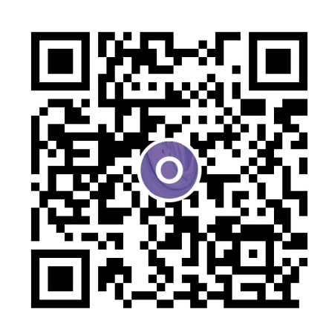






Buy me a coffee?
Any question?
wa.me/6281315269591
https://github.com/hasanalbantani
https://www.youtube.com/
channel/UCBrN_tGzXfciVJtIkT43I4w

Slide 11


